Slide 1

Topic: Number
EQ: How do we use the Order of Operations to work out equations?

Slide 2
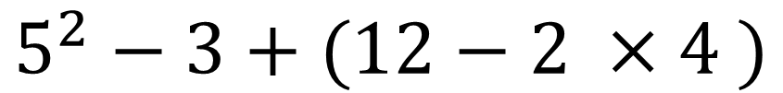
Work this equation out……
Don’t use a calculator and don’t look at anyone else’s answer…..
$$5^{2}−3+(12−2 ×4 )$$
What was your answer?
Notes:
Answer: 26

Slide 3
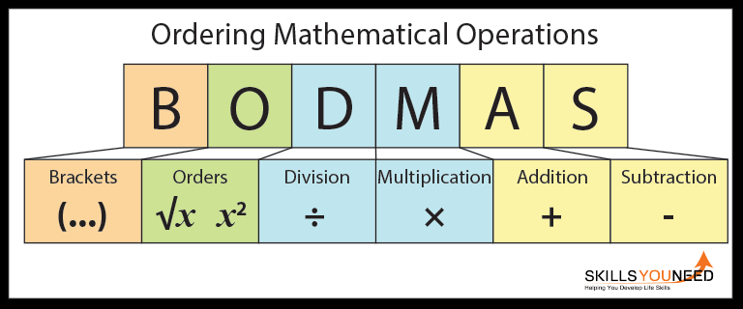
Order of Operations
We need to have a system so that we can all work out the same answer
BODMAS

Slide 4
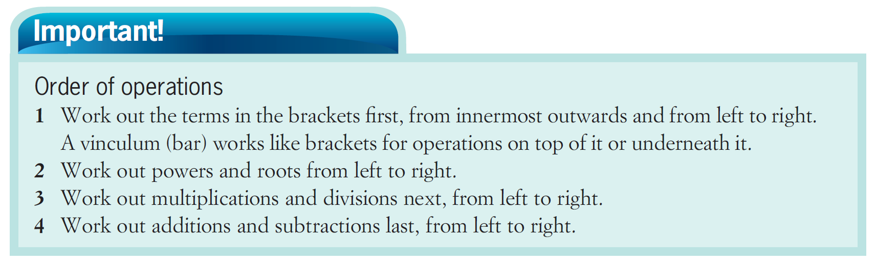

Slide 5
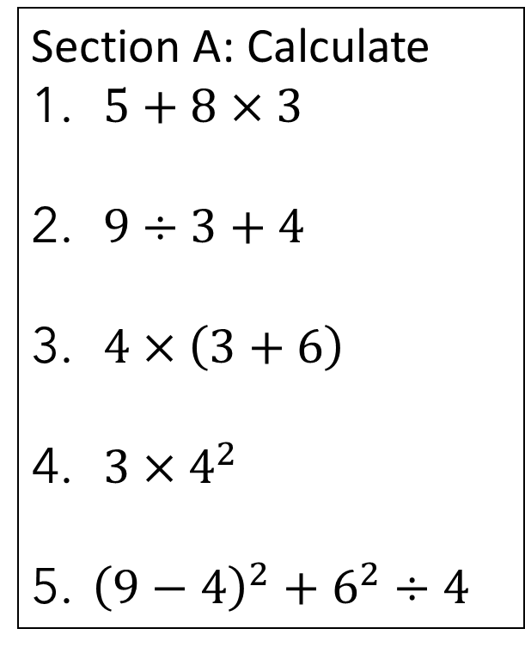
Lets try some together….
Section A: Calculate
$5+8×3$
$9÷3+4$
$4×\left(3+6\right)$
$3×4^{2}$
${\left(9−4\right)}^{2}+6^{2}÷4$

Slide 6
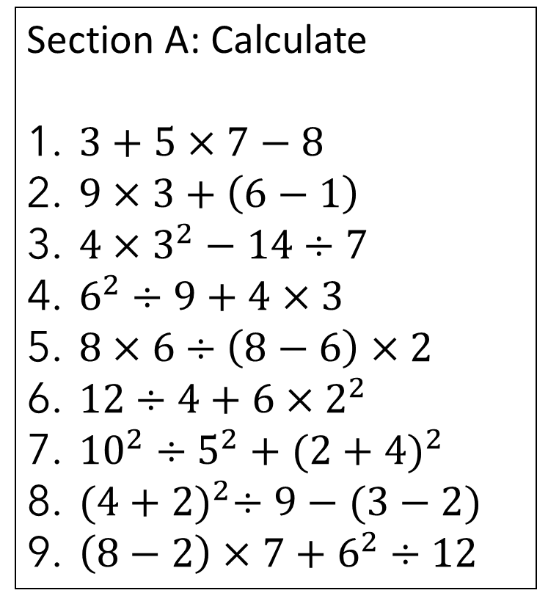
Now you try….
Section A: Calculate
$3+5×7−8$
$9×3+\left(6−1\right)$
$4×3^{2}−14÷7$
$6^{2}÷9+4×3$
$8×6÷\left(8−6\right)×2$
$12÷4+6×2^{2}$
${10}^{2}÷5^{2}+{(2+4)}^{2}$
${(4+2)}^{2}÷9−(3−2)$
$\left(8−2\right)×7+6^{2}÷12$

Slide 7

What about roots?
Work out what’s underneath the square root first
Then work out the root and power
Then do the multiplication and division from left to right
Finish with addition and subtraction from left to right

Slide 8
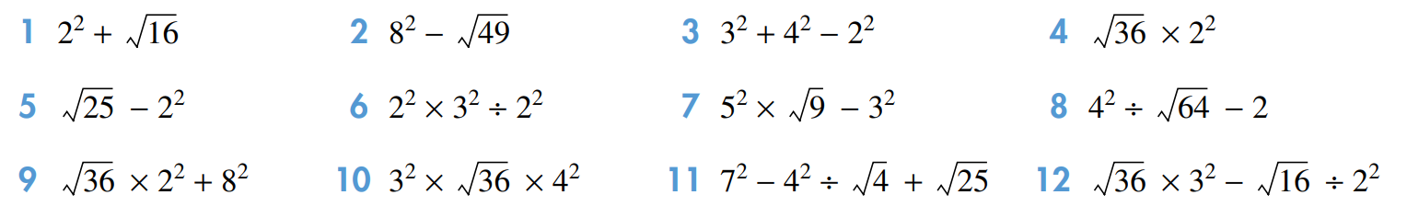
Try these…..

Slide 9
Exercise
Haese Cht 1 c and e
Nelson Ex 1.04

